Slide 1
How to Support your child in Years 5 & 6

Slide 2
Reading (including phonics)
Read often
Listen to your child read their class book
Engage in Online Reading Buddy
Record in yellow reading record books
Read a variety of books to your child
Discuss new and interesting words
Read a rage of books, fiction, non-fiction, recipe books, dictionaries etc
Discuss the books
Ask questions about what has happened
Ask ‘why do you think…?’
Ask ‘how do you know…?’

Slide 3
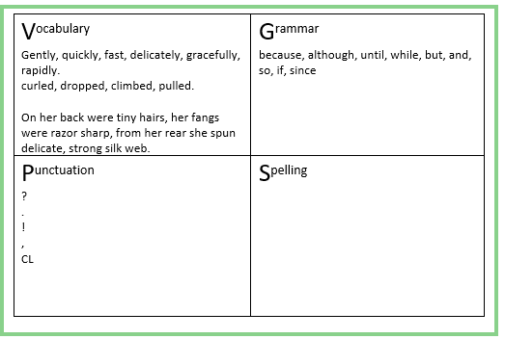
Writing
What we do in school
Write different genre and for different purposes
Discuss the content
Plan
VGPS
Paragraphs and content
Edit
Reread and correct
Up-level to improve
Use a thesaurus (online or book)
Handwriting practise
Cursive formation

Slide 4
Terminology
Adjective – describes a noun
Adverb – describes a verb
Expanded noun phrase – a descriptive clause
Adverbial phrases – a group of words telling us ‘how, when, where, why, how long’
Inverted commas – often known as speech marks
Colon - used to precede a list of items, a quotation, or an expansion or explanation
Semi-colon - indicating a pause, typically between two main clauses, that is more pronounced than that indicated by a comma.

Slide 5
Spellings
Read a variety of books to recognise words and spelling patterns
Practise words from the year group lists
Practise writing common errors
Look, cover, say, write
Use a dictionary (online or book)
Play online spelling games

Slide 6
Maths
Number Place Value
Count! In 1s as well as groups
Real-life problem solving
Tell the time – analogue and digital
Board games using maths skills
Arithmetic practise – online games
Times tables
Engage with TTRS
Play online games

Slide 7
Maths
Calculation strategies – Year 5

Slide 8
Maths
Calculation strategies – Year 5

Slide 9
Maths
Calculation strategies – Year 5

Slide 10
Maths
Calculation strategies – Year 5

Slide 11
Maths
Calculation strategies – Year 6

Slide 12
Maths
Calculation strategies – Year 6

Slide 13
Maths
Calculation strategies – Year 6

Slide 14
Maths
Calculation strategies – Year 6

Slide 15
Homework
Discuss the task.
What do they plan to do?
How will your child challenge themself? ‘Must, should or could’?
Do you have anything that could help? Books, online searching together
Share your experiences

Slide 16
Basic Skills
Independence – packing their own bags etc
Making their own lunches
Telling the time
Perseverance – not giving up on things!
Having a go at their homework first before asking for help
Changing the task to have a fun element or easier

Slide 17
Any questions?

