Slide 1
River Dart Country Park Year 6 Residential 2024

Slide 2
River Dart Country Park
We are delighted to inform you that we are once again able to begin planning a residential visit for the pupils who will be in Year 6 during the next academic year (2024-25).
We know that the residential is a highlight of many pupils’ time at William Harding School and that it is an excellent opportunity for them to develop independence and resilience as they prepare for their first year of secondary school.
The visit will take place from Monday 21st October 2024 to Friday 25th October 2024 and will include a total of four nights overnight stay with all meals and accommodation provided.

Slide 3
River Dart Country Park
We have decided, based on feedback from staff, parents and pupils, to return to the ever-popular River Dart Country Park in Devon.
The trip and all activities will be run by CRS Adventures, as in previous years.
Children will participate in a wide range of outdoor and adventurous activities throughout the week, enabling the school to enhance the children’s access to and experience with outdoor and adventurous education.
There is also a strong emphasis throughout the week on encouraging the children to develop their skills of independence, resilience and teamwork.
CRS Adventures Limited is a well-established company in this industry who are recognised for the high standards they set for health, safety and staff training.

Slide 4
https://www.youtube.com/watch?v=lYfwJ-9S93c

Slide 5
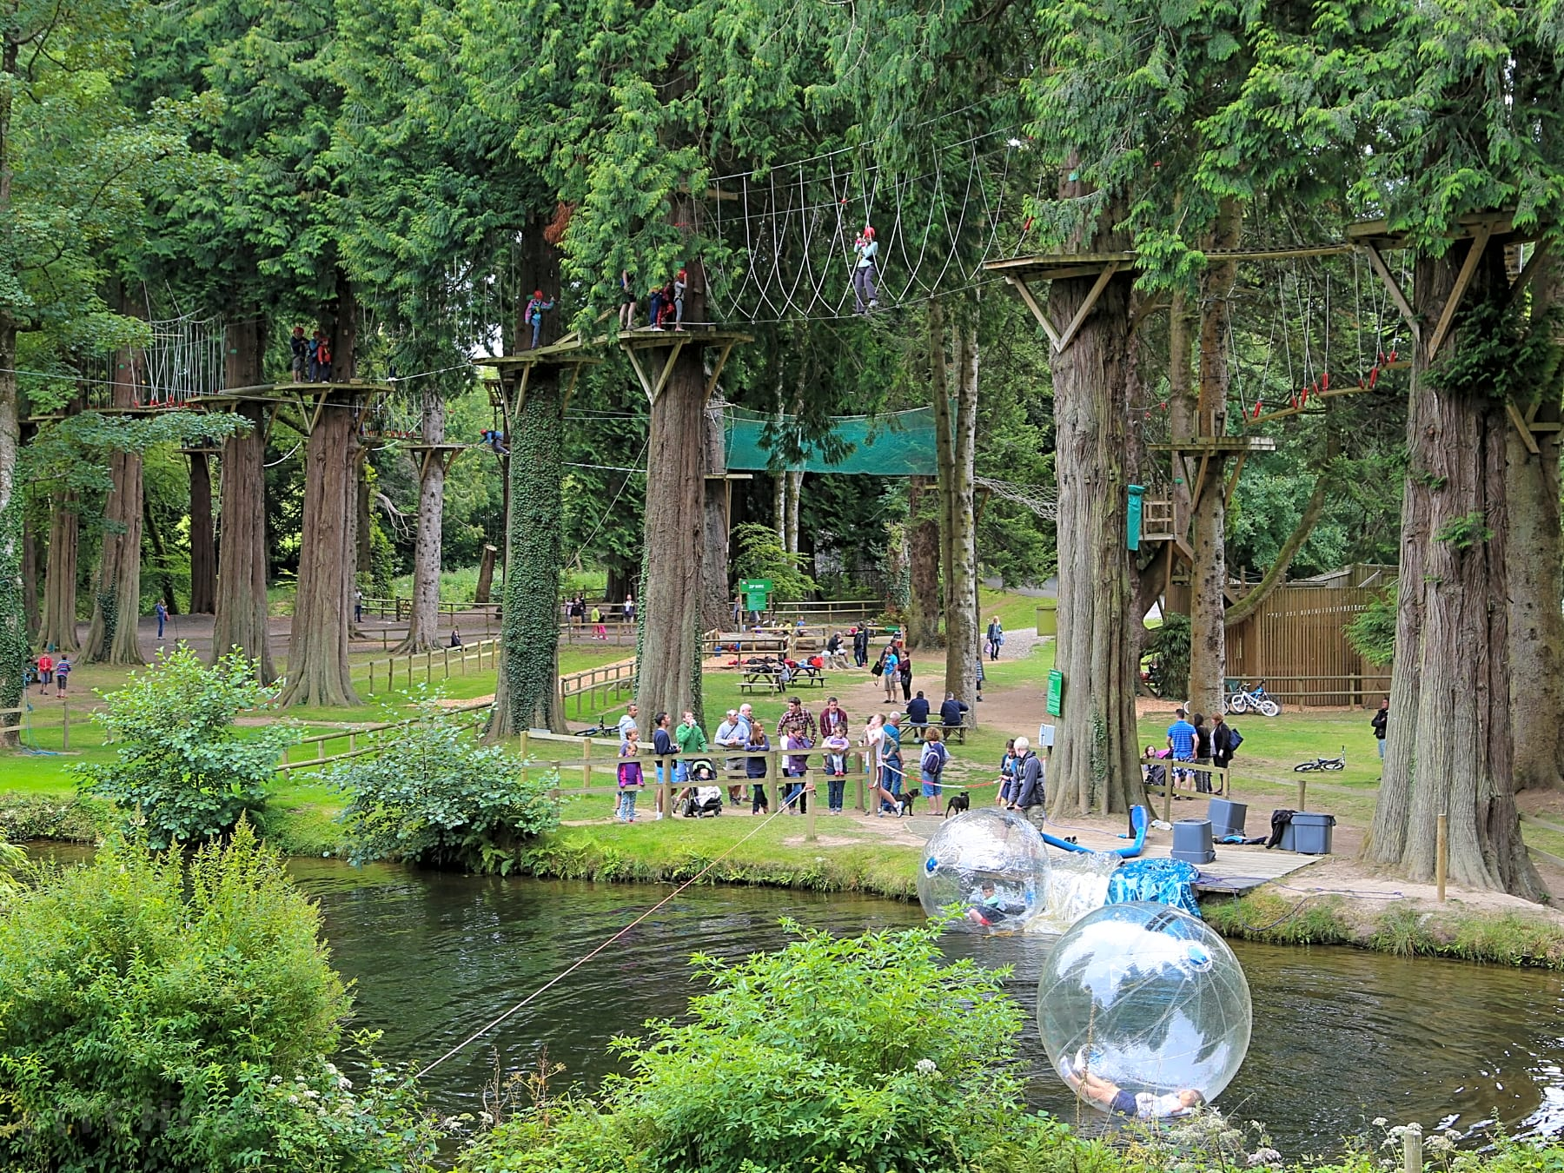
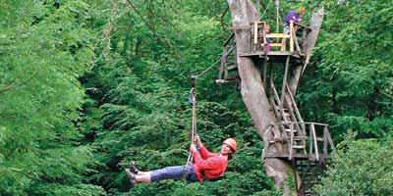
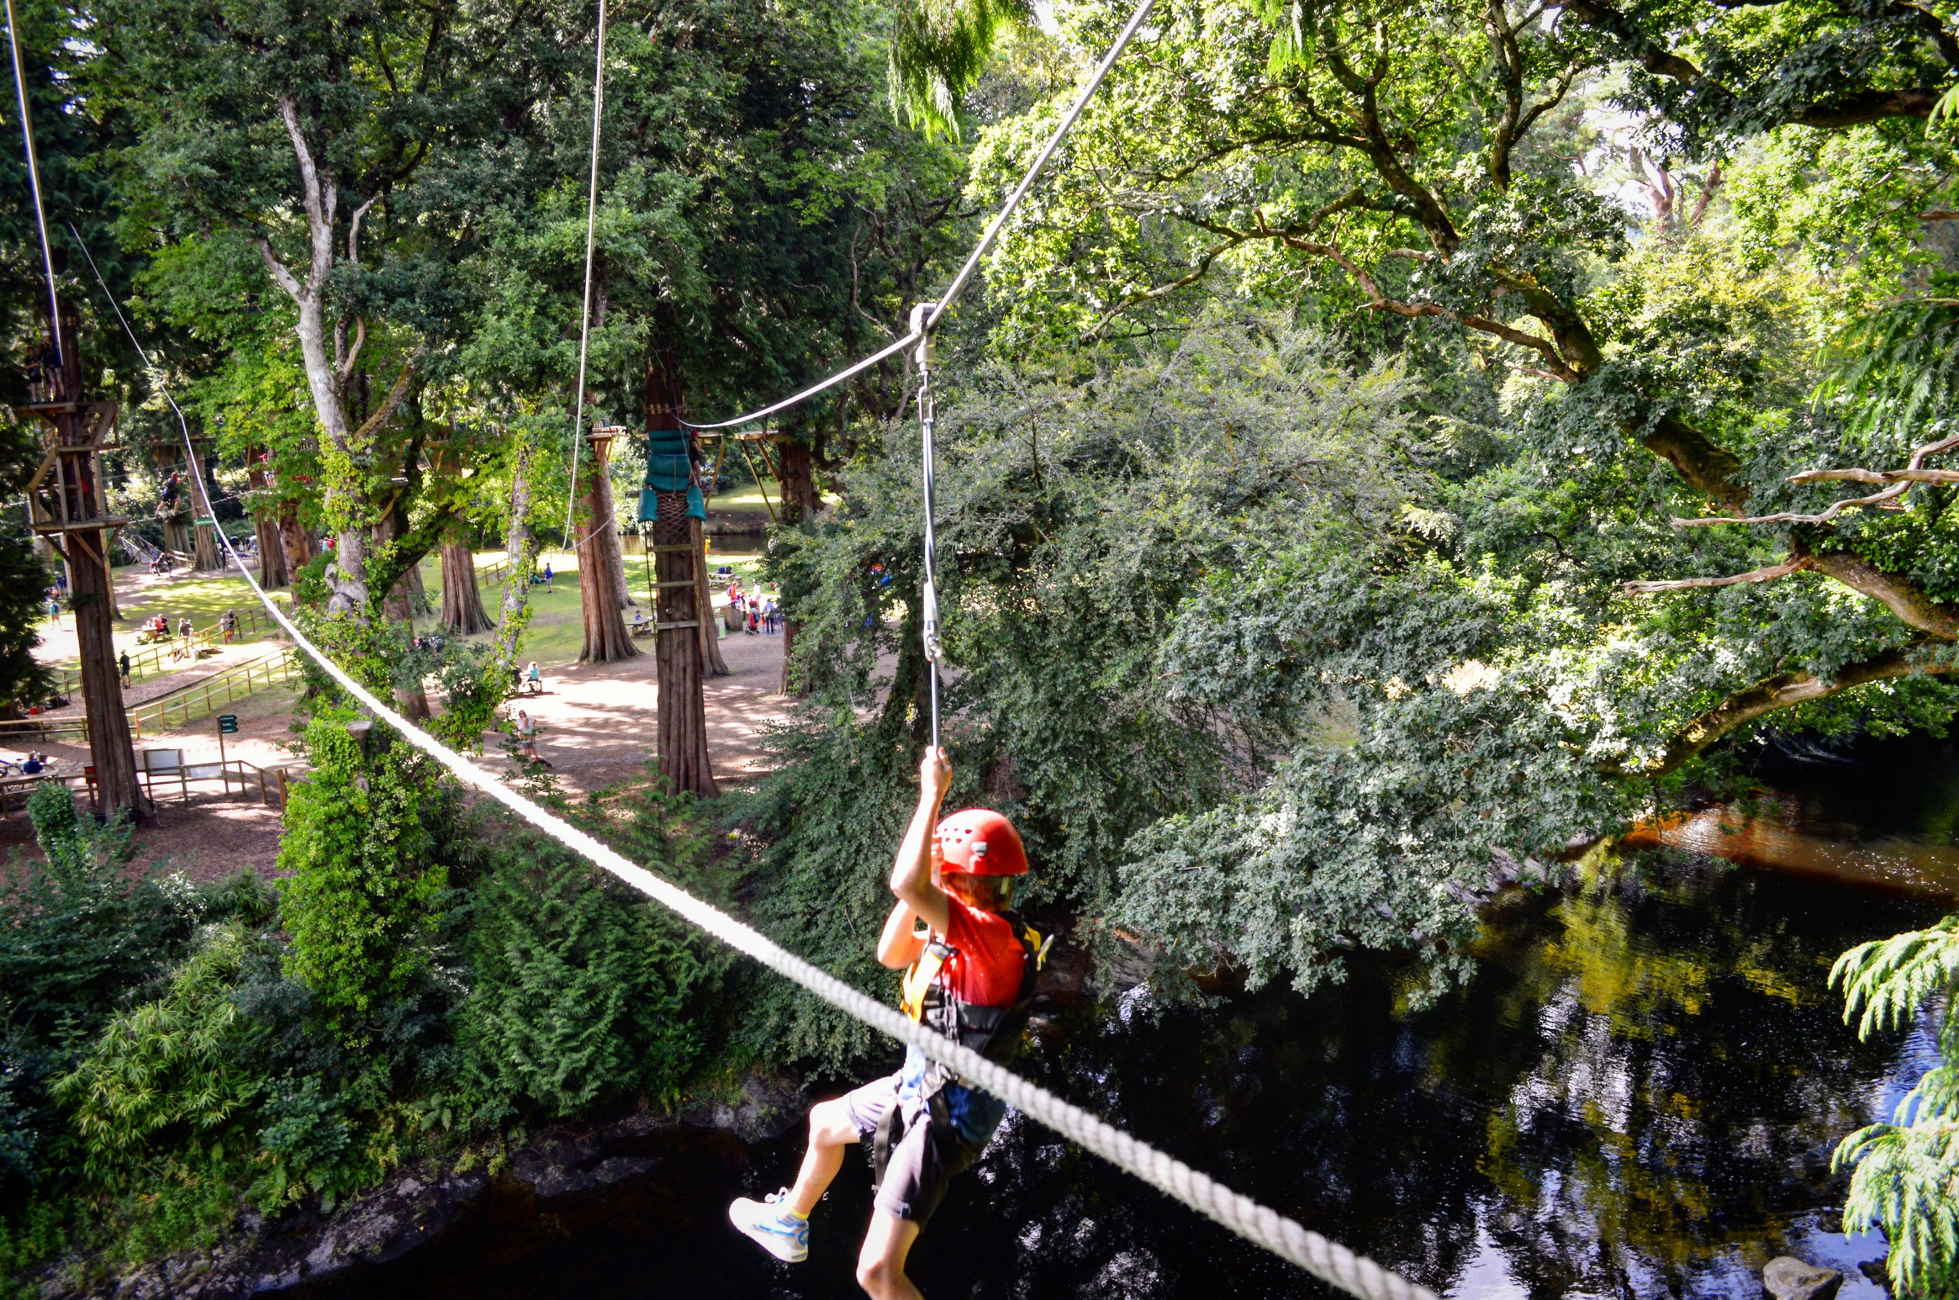
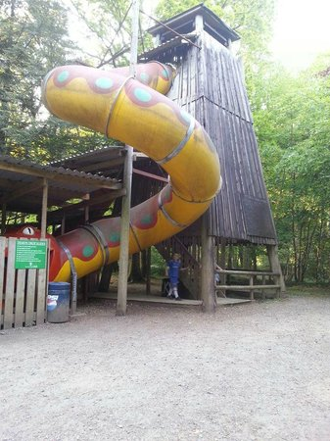
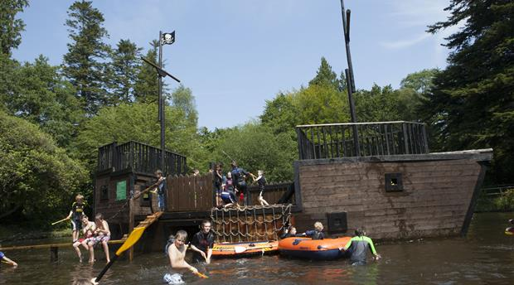
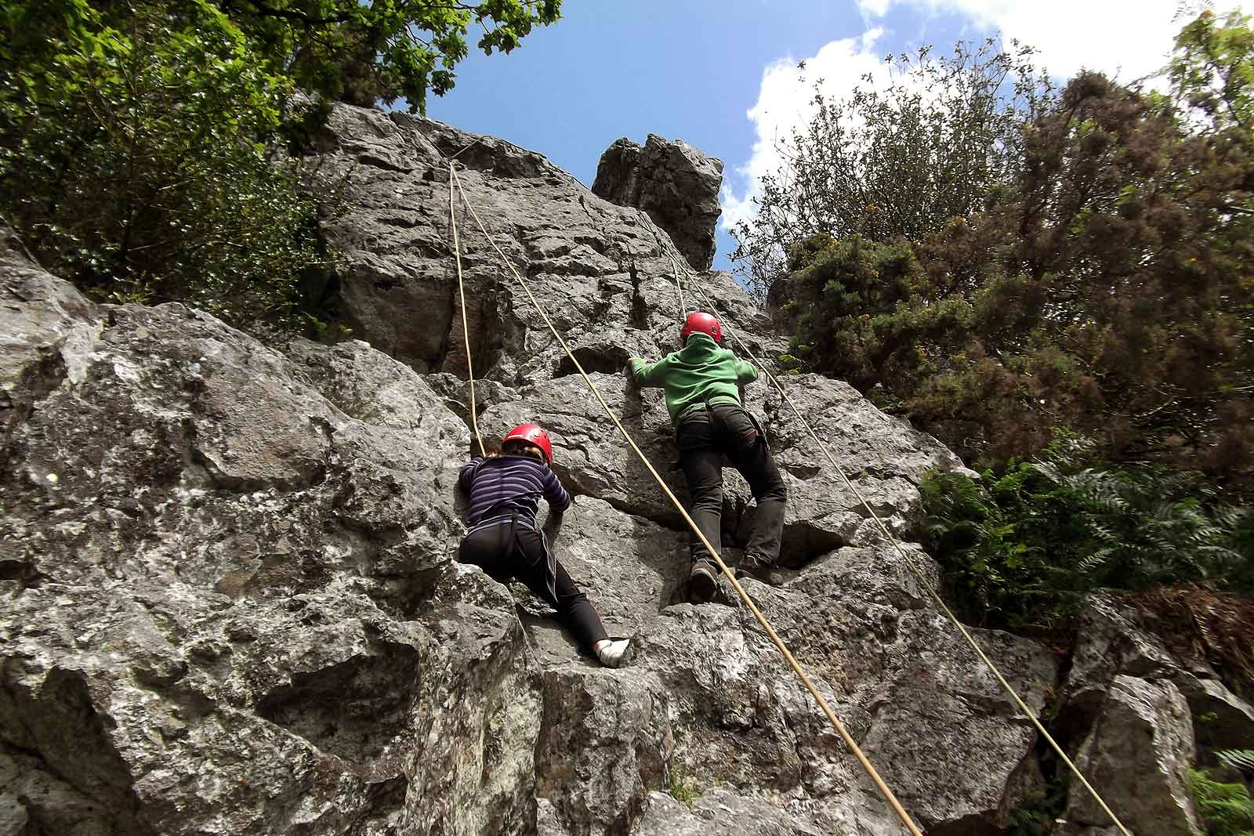
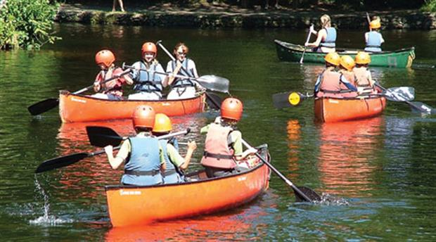
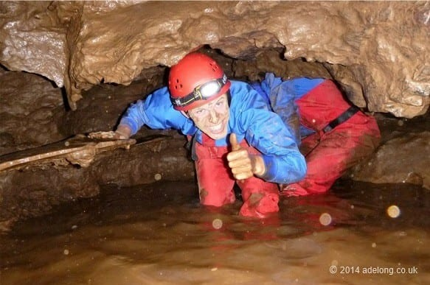

Slide 6
Daily timetable
Cooked breakfast
Morning activity
Cooked lunch
Afternoon activity
Cooked dinner with dessert
Evening activity

Slide 7
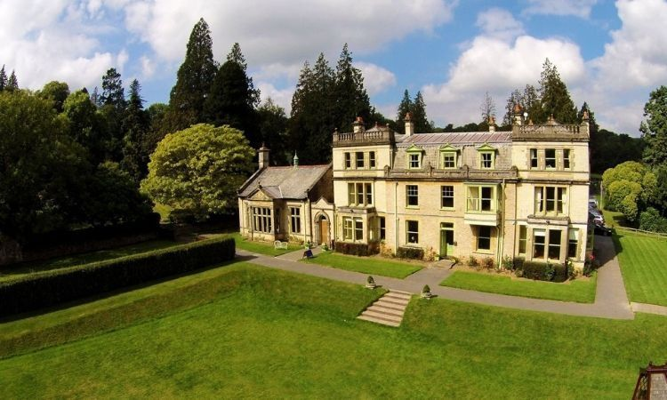
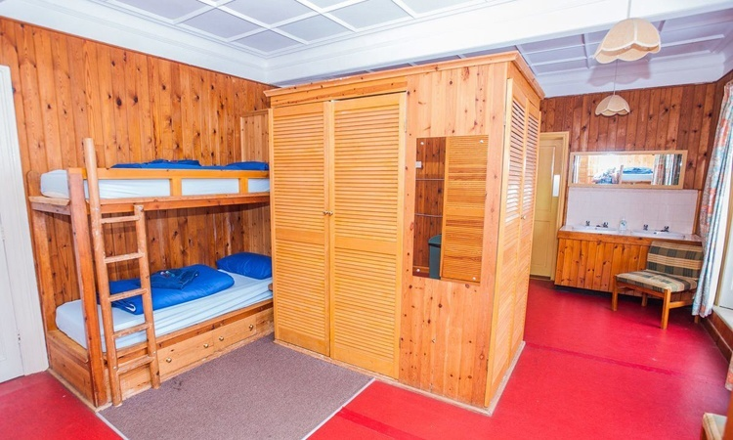
Accommodation
Holne Park House
Sleeps up to 12 people
Variety of room sizes
Sole-occupancy

Slide 8
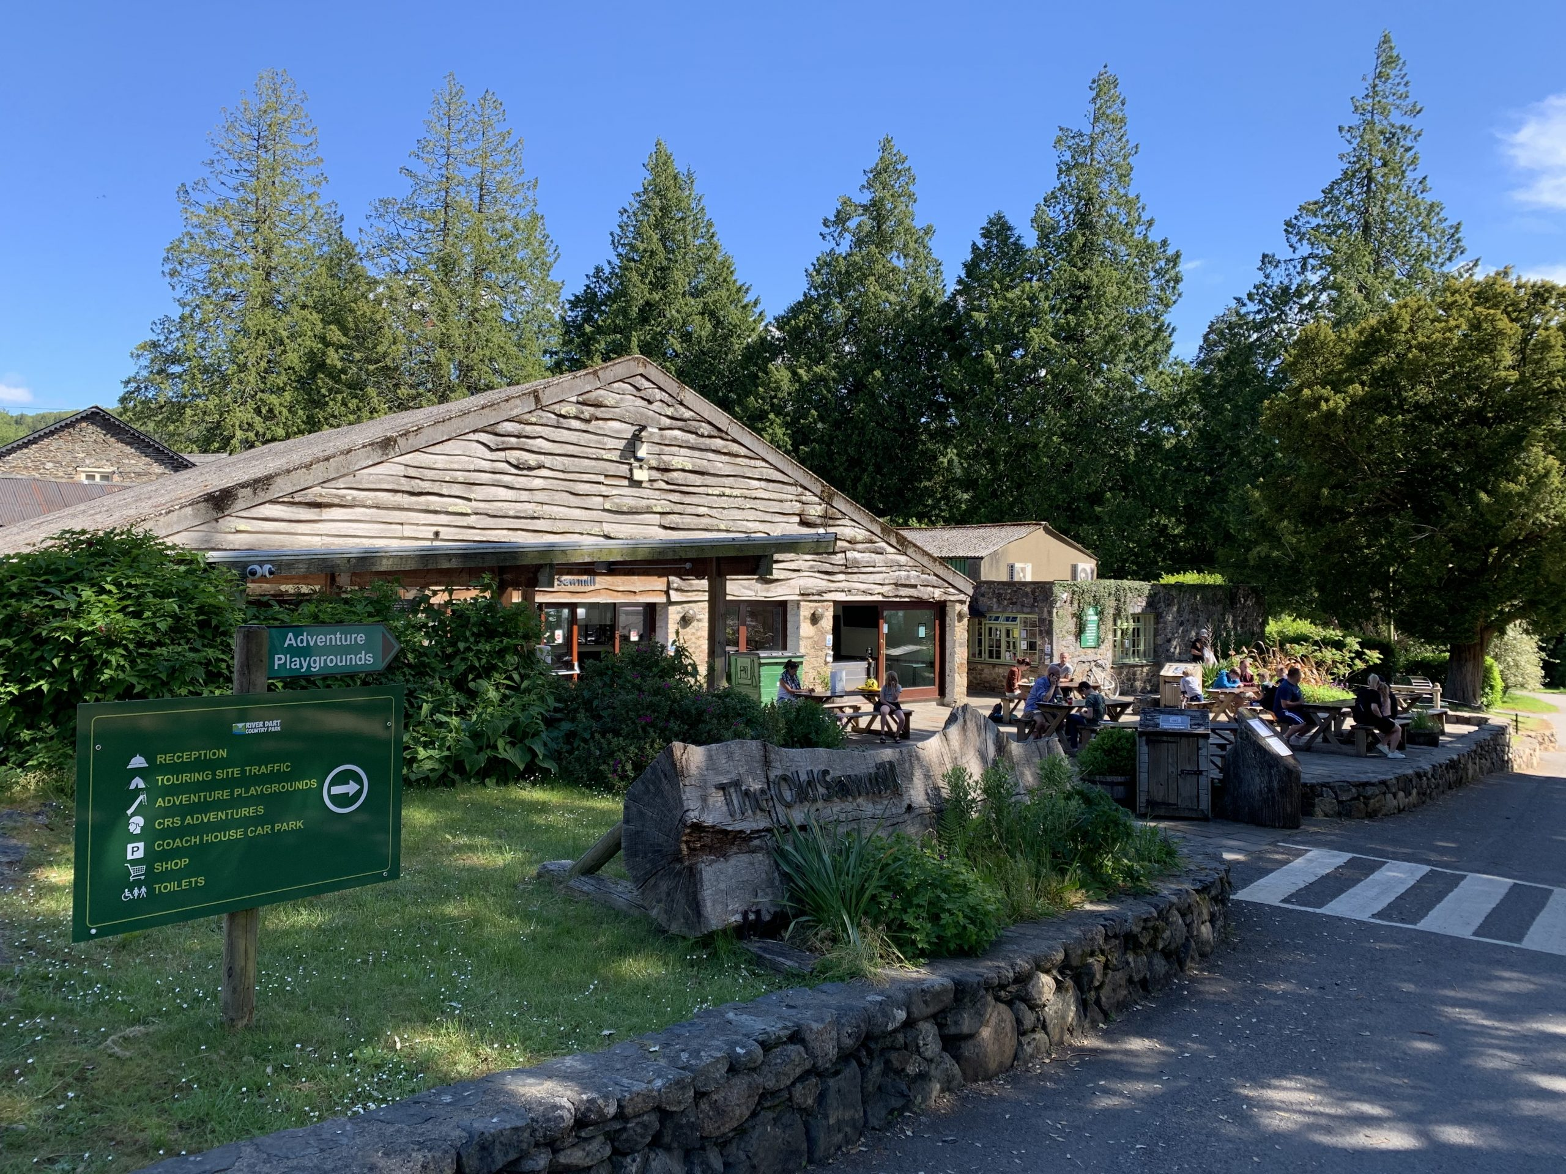
Food
The Old Sawmill
3 hot meals a day
Child friendly meals
Dessert with dinner
Cater to dietary needs

Slide 9
Pupil Comments
‘River Dart was great – the instructors was amazing, fun, helpful and kind’ MR
‘I wish I could go back – make sure you go and enjoy it!’ DV
‘I got to tip Mr Dawson out of his kayak and into the lake!’ EP
‘I absolutely loved rock climbing – it was amazing!’ GH
‘River Dart was an amazing experience and the sausage rolls on top of the hill were lovely.’ BS
‘I faced lots of fear at River Dart so I was really proud of myself.’ PT
‘I made new friends on the trip.’ KS
‘The rooms were huge! We had 12 people in ours and triple bunk beds!’ HB

Slide 10
Cost and WH Trust
The total cost of the trip depends on the numbers of children who attend, however this is likely to be in the region of £460. The cost of board and lodging will be £230 per pupil and the cost of activities will be £200 per pupil, plus the costs of the coach which will depend on numbers. We will confirm the exact cost once numbers are known.
Parents/carers of children in receipt of means tested benefit may be eligible for support from the school or from the William Harding Trust. Where this is the case, please speak to Mrs Smith in the school office for further information.
In order that we can ascertain whether it will be possible to run the trip and pay the deposit, we need to ask for the cost of the room and board (£230) to be paid by Friday 3rd May 2024. Payments should be made online, either in full or in instalments via the School Gateway.
The remaining payment will be due by Friday 6th September 2024. You may make payments either in full or in instalments via the School Gateway.

Slide 11
Useful links for additional information
https://riverdart.co.uk/
https://www.youtube.com/watch?v=IuaaWqaMQBA

Slide 12
Any questions?

