Slide 1
Welcome to Year 3 2023 - 24

Slide 2
Staffing
Teachers
Miss Farid (Beech) (Year Lead)
Miss Williams (Willow)
Miss Galliot (Hawthorn)
Mrs Batory and Mrs Choy (Rowan)
TAs
Miss Lewis (Lead TA)
Mrs Ludlow
Miss Roberts
Mrs Foulkes
Miss Wajeeha
Mrs Tanaka
Mr Rayner (Sports Coach)
Mrs Charlton (Music)
Mrs Sharp
(Assistant Headteacher)

Slide 3
FLO Team
Pastoral support for children and families
Mrs Bone (Lead)
Mrs White
Mrs Wood (School Counsellor)
Mrs Skinner IPSL

Slide 4
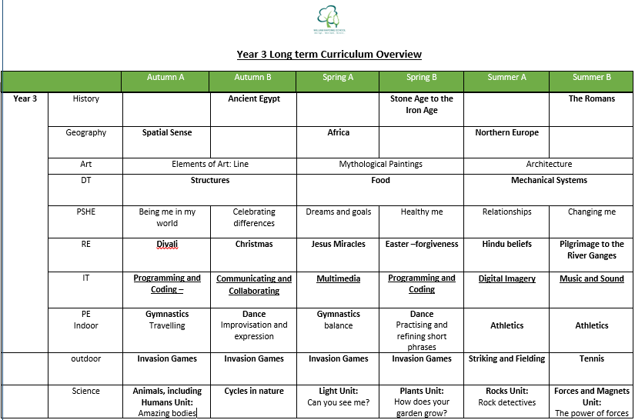
Curriculum Overview

Slide 5
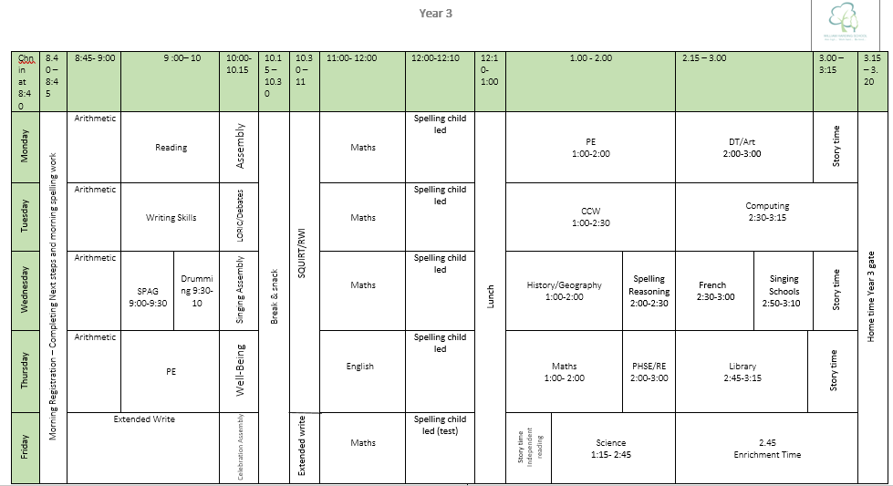
Example Timetable

Slide 6
New Lessons – New Key Stage
French
30min lessons a week
Lots of songs, interaction and practical lessons
Arithmetic
10 mins a day practice and revision of known calculations
Child led spelling
10mins a day
Children direct own learning using year 3 spellings
Practice and assess in pairs
Test at the end of the week
Developing independence, responsibility & initiative
Additional Music
Drumming
Weekly 30 mins for half a term

Slide 7
Stationary and Equipment
Children are expected to bring in a clear, small pencil case
This must contain a pencil, red pen, blue pen, green pencil, orange pencil, whiteboard pen, ruler, rubber, glue stick, 2 different coloured highlighters and pencil sharpener (with spares!)
Named water bottles for throughout the day (extra to lunch)
Children must bring in a named PE kit that includes a pair of shorts/tracksuit, t-shirt in the colour of their house, trainers and hair band if they need it. Please ensure ear rings are taken out or covered up on PE days, both indoor and outdoor all year round. Please note a slip will be sent home if your child comes in incorrect school uniform.

Slide 8
Reading
Reading books to take home:
a free reader or book banded book from the year group library to be read independently but discussed with an adult
a library book which can be read with an adult
a RWI e-book that matches their RWI group level to be read independently if working on RWI
Children are expected to read at least 3 times a week. Children earn Dojo points for Reading Rocks by:
Reading 3 times a week (RWI book, home reader, library, any other book!)
Reading books from the class list
Reading Online Buddy & RWI online
Bringing in their signed reading record books

Slide 9
Transition Work
PSHE unit ‘Changing Me’ focusing on growing up and moving on
Assemblies and class discussions on coping with changes
Teachers and TAs spending time with individual children as needed
FLO support for specific children as needed
Thorough staff handover
New teachers observing the class
MUSU – allowing children to settle before the summer holidays

Slide 10
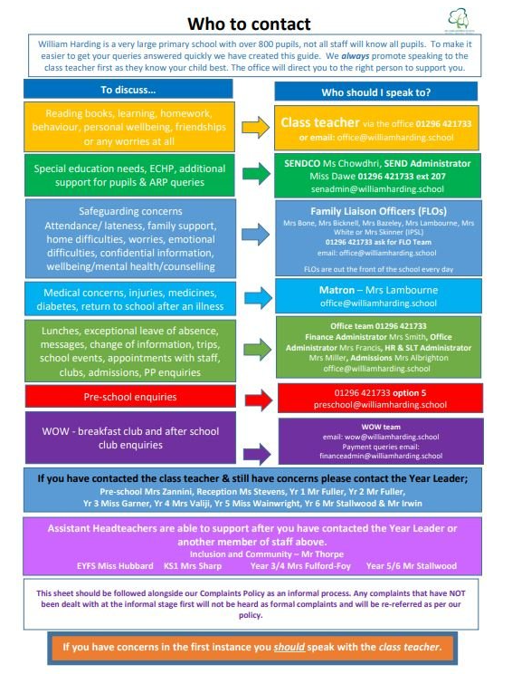

Slide 11
Any questions?

