Slide 1
Woodrow High House
Residential Trip

Slide 2
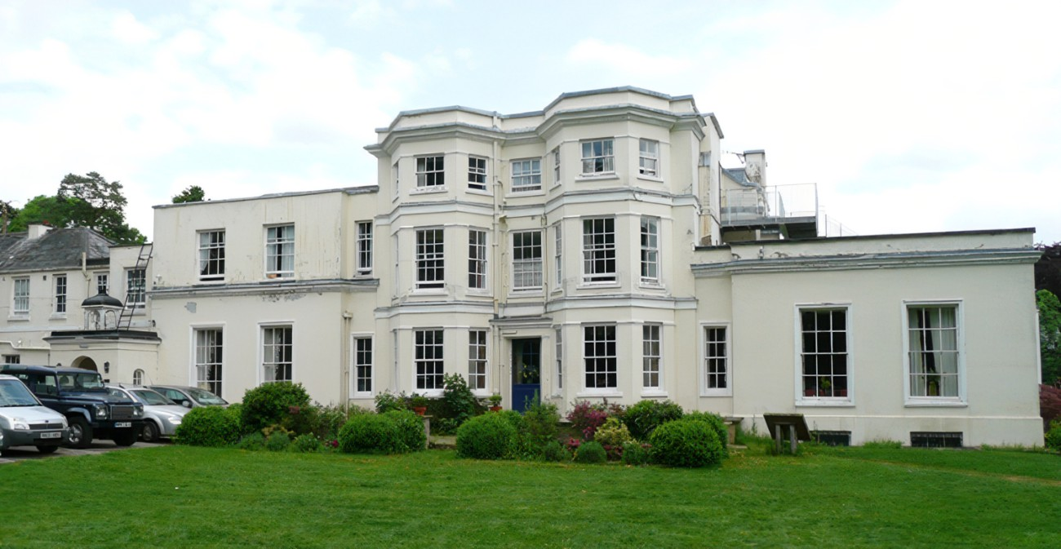
Woodrow High House is a grade II listed manor house buried deep in the Chilterns.
Around 30 minutes drive from William Harding School.
Woodrow High House e-Brochure (canva.com)
Discover Woodrow High House | Winter 2022 - YouTube

Slide 3
The trip
Three days and two nights
Breakfast, lunch and dinner is provided. On the first day your child will need lunch. All dietary requirements will be taken into consideration prior to arriving. There will be a selection of hot food, fruit and water available to children.
Every day, three outdoor activities take place with a fully trained instructor.
In the evening, there will be some form of entertainment. Usually, a campfire organised by the staff at Woodrow and a disco supervised by William Harding staff.

Slide 7
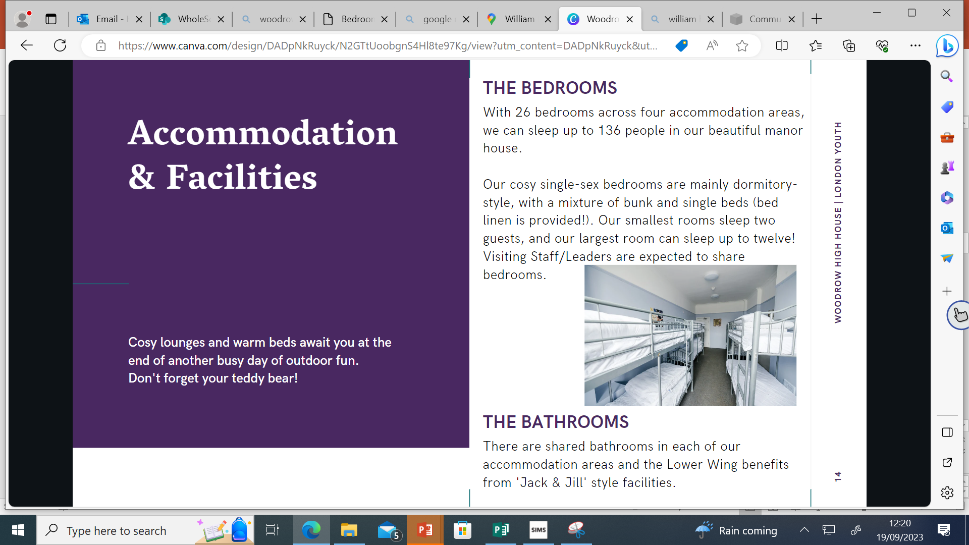

Slide 8
Bedrooms
Your child will sleep in a room that consists of bunk beds. The rooms vary in size to accommodate groups of 6-10 children.
They are split up into zones and a teacher is responsible for each zone.
Prior to the trip, the class teacher will ask your child to write down five children they would like to share a room with. We will try to ensure that every child has at least two of their friends in their room.

Slide 13
Why send your child to Woodrow?

Slide 14
Any questions?

