Slide 1
Zones of Regulation
Date….

Slide 2
Aims
To understand the schools approach to Zones of Regulation and Emotional Literacy
Explore a range of approaches and techniques

Slide 3
Guided Meditation!

Slide 4
Zones of Regulation
Children’s wellbeing is at the heart of what we do as teachers, if we have happy, calm children, it is much easier to teach!
Builds on the Zones of Regulation work we have already done, the Wellbeing sessions we run and fits in to our Behaviour Policy
The Zones provides a neutral and simple language and a systematic framework, improving communication for students
Increases both student and staff skills and efficacy in SEL while decreasing the need for punitive measures within a school site

Slide 5
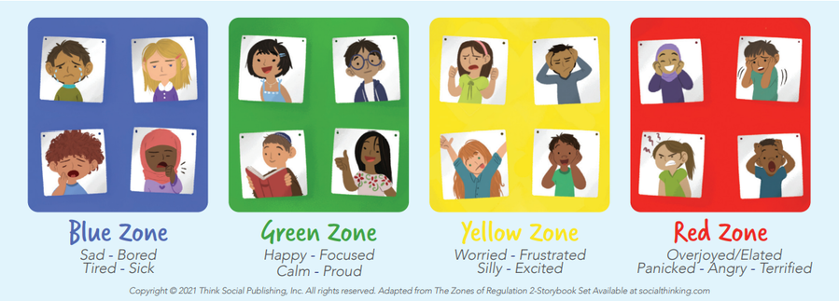
Zones of Regulation: Recap
Emotions are divided into 4 main areas:

Slide 6
Red Zone
Very high Energy, negative emotions
Anger
Elation
Scared
Panicked
Scared
Fight or flight
Boiling/exploding

Slide 7
Blue Zone
Low energy, negative emotions
Sad
Depressed
Despondent
Bored
Tired/sleepy
Sick/ill

Slide 8
Yellow Zone
High energy, warning zone emotions, usually the trigger for negative behaviours
Worried
Frustrated
Nervous
Irritated
Silly
Exiting
Anxious
‘Bubbling’

Slide 9
Green Zone
Highish energy, positive emotions
Ideal place for learning, where we want the children to be
Calm
Happy
Focused
Engaged
On task
Proud
I know I am doing a good job

Slide 10
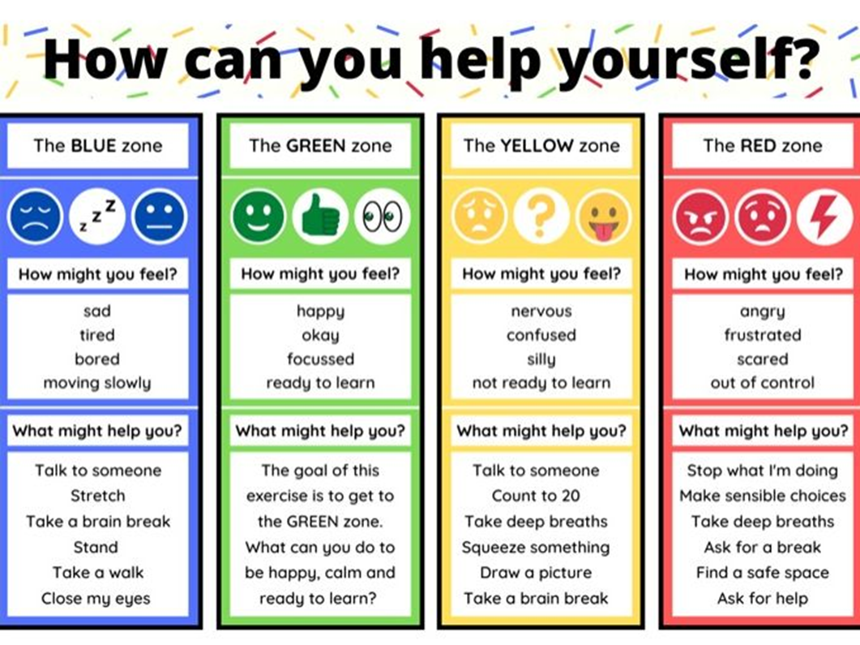
Strategies

Slide 11
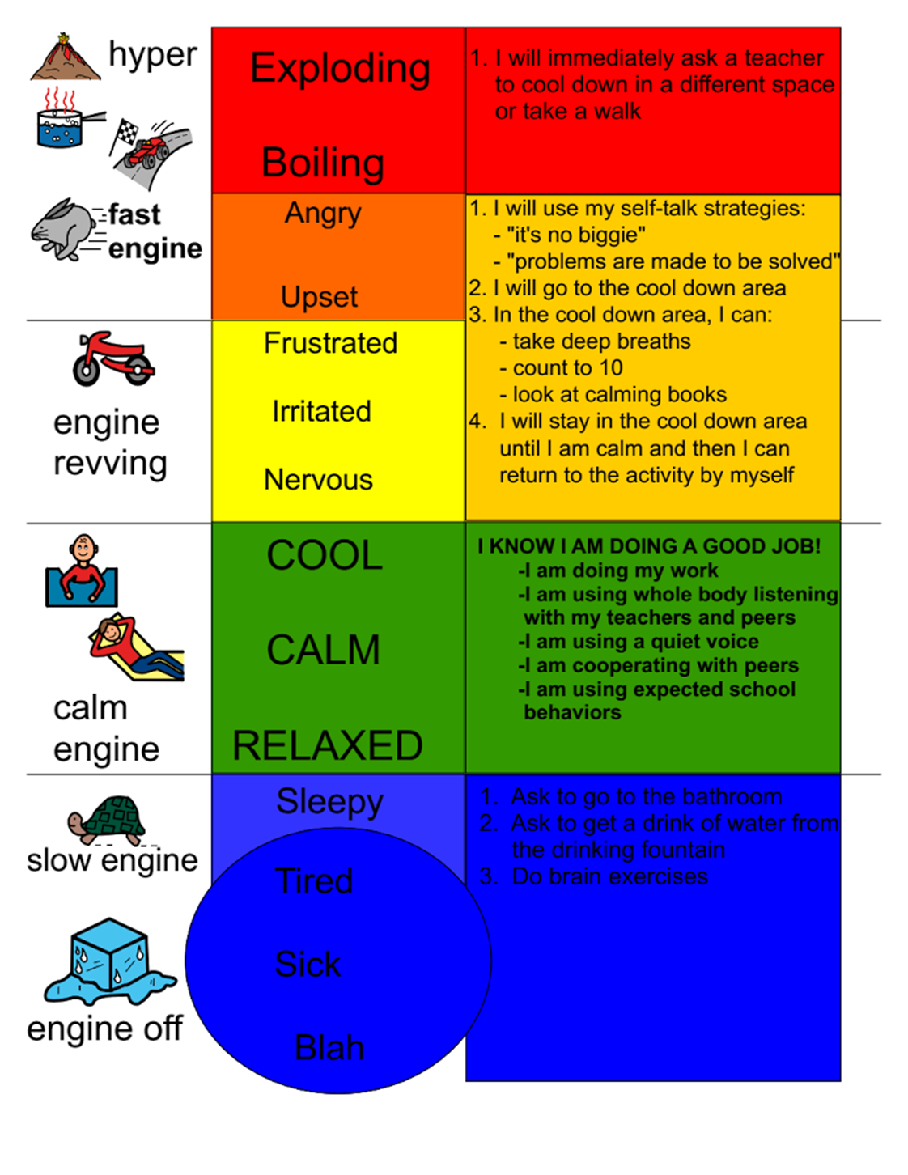
Strategies

Slide 12
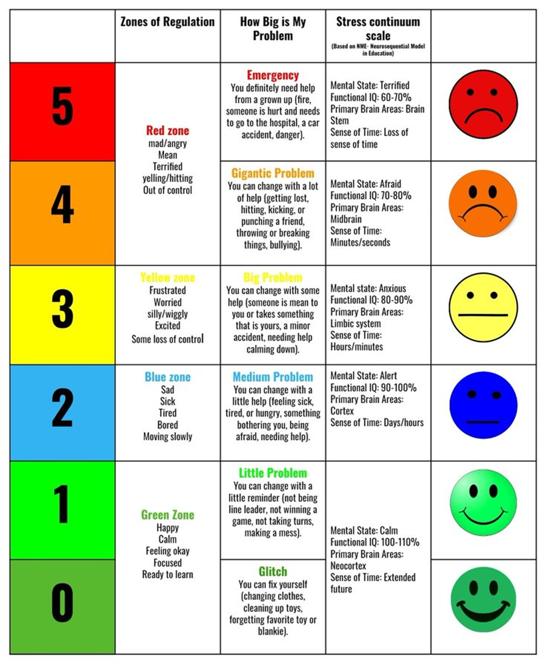
Strategies

Slide 13
First Lesson
First lesson will be the ZoR introduction
This will help the children identify the emotions and categorise them under the correct colour, this will help the children to ‘label’ their emotions by giving them this vocabulary

Slide 14
First Lesson: Structure
Start with a guided meditation, then explore the feeling of being calm, relaxed and focused
Look at a selection of pictures, get the children to identify the emotions in them
Explain these emotions can be sorted into categories, then introduce the categories
Have the children then sort emotions from the pictures into the categories, older children may then suggest other emotions that may fit into these
Activity, KS1 based around categorising these emotions, KS2, look at strategies to get themselves into the green zone

Slide 15
Zones of Regulation Lessons
After the first lesson, Zone of Regulation will take place twice a half term and focus on giving children strategies to help them get into the Green Zone
The aim is to empower children to identify their emotions and select a strategies to regulate themselves
This will involve looking at startegies, how and when to use them, case studies etc.
Each session will be planned for you, you just need to deliver them
They will be split into a Key Stage 1 and Key Stage 2 Powerpoint

Slide 16
Check ins
It is important to allow the children to ‘check in’ a couple of times a day
This can take the form of Guided Meditations, Mindfulness colouring, Listing to calming music etc
The goal is to get themselves into the ‘Green Zone’ so they are ready for learning
Fast and relatively simple way to get the children to regulate themselves
Takes 2-3 minutes
Once the children have ‘checked in’, allow the children the opportunity to identify what Zone they are in, this could take the form of names on lollysticks and putting them into a Red/Yellow/Green/Blue pot
TA’s will then take a group of children (depending on which colour pot has the most names in, not Green) and take a few minutes in the lesson starter to take the children out or somewhere quiet and use one of the strategies to regulate themselves
TAs will receive this training next week, so will be prepared

Slide 17
Next Steps
Teach the Introductory Zones of Regulation lesson
Allow 3-5 minutes at the beginning of the day and after lunchtime, use the scripts on the WHW if needed
Teach each Zones of Regulation session in your wellbeing slot
Allow your TA time for the first part/starter of you lesson to take out a group of children and use one of the strategies to help the children regulate

