Slide 1
How to Support your child in Years 1 & 2

Slide 2
Reading (including phonics)
Read often
Listen to your child read their class book
Engage in Online Reading Buddy
Record in yellow reading record books
Read a variety of books to your child
Discuss new and interesting words
Read a rage of books, fiction, non-fiction, recipe books, dictionaries etc
Discuss the books
Ask questions about what has happened
Ask ‘why do you think…?’
Ask ‘how do you know…?’

Slide 3
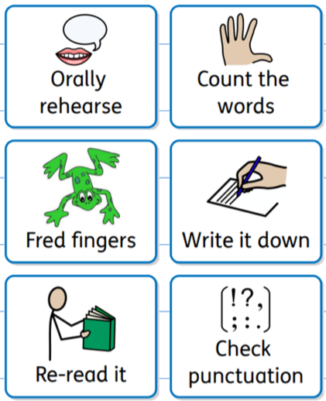
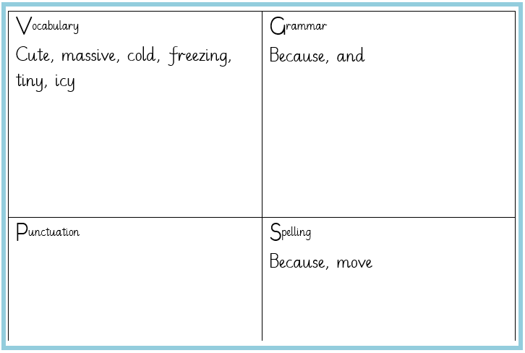
Writing
What we do in school
Write different genre and for different purposes
Discuss the content
Plan
VGPS
Paragraphs and content
Edit
Reread and correct
Up-level to improve
Use a thesaurus (online or book)
Handwriting practise
Cursive formation

Slide 4
Terminology
Noun – the name of a person, place or thing (John, London, chair)
Adjective – describes a noun (beautiful, spooky, enormous)
Adverb – describes a verb (quickly, bravely, always)
Noun Phrase – a descriptive clause (red bug)
Expanded noun phrase – a descriptive clause (bright, red bug)

Slide 5
Spellings
Read a variety of books to recognise words and spelling patterns
Practise words from the year group lists
Practise writing common errors
Look, cover, say, write, check
Use a dictionary (online or book)
Play online spelling games
Spellings of the Week

Slide 6
Maths
Number Place Value
Count! In 1s as well as groups
Real-life problem solving
Tell the time – analogue and digital
Board games using maths skills
Arithmetic practise – online games
Times tables
Engage with TTRS (Autumn 2 – Year 2)
Play online games
Odd and Even number

Slide 7
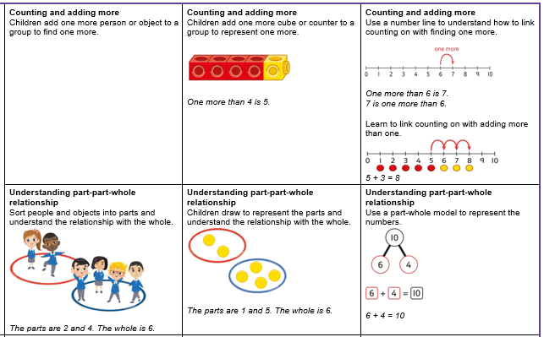
Addition – YR1

Slide 8
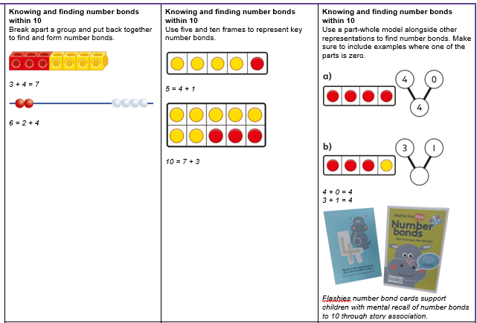
Addition – YR1

Slide 9
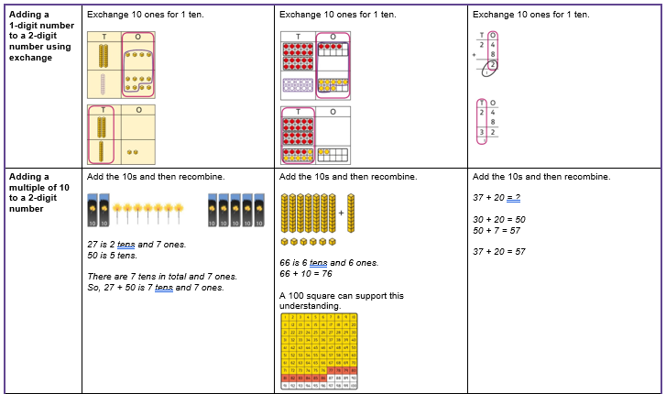
Addition Y2

Slide 10
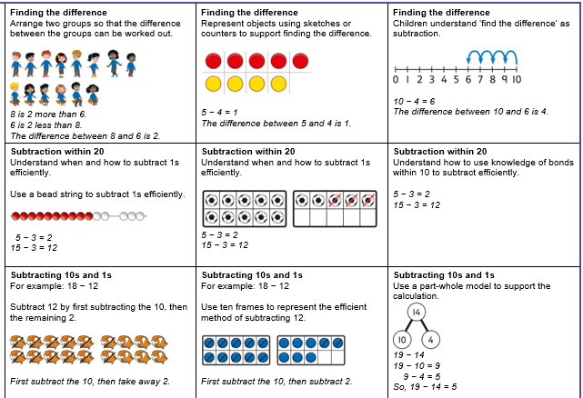
Subtraction – Y1

Slide 11
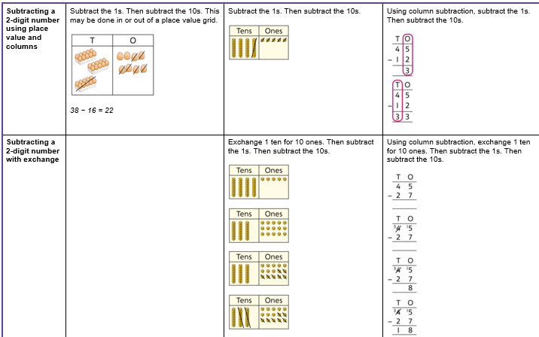
Subtraction - Y2

Slide 12
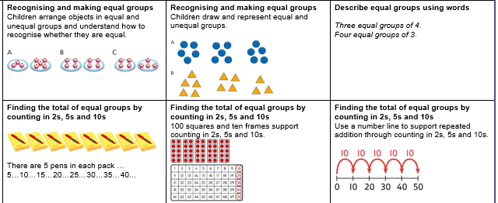
Multiplication – Y1

Slide 13
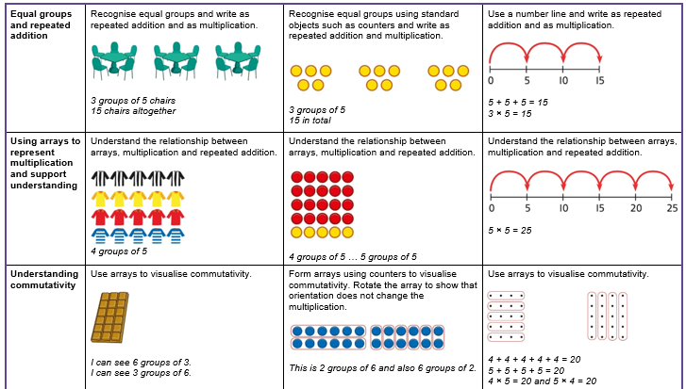
Multiplication – Y2

Slide 14
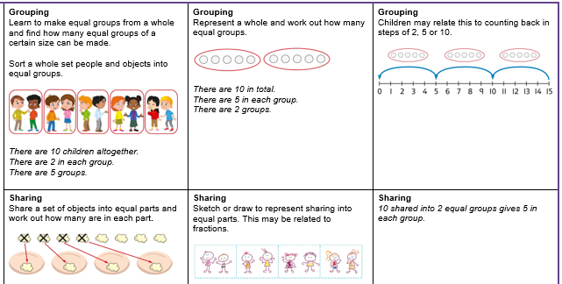
Division - Y1

Slide 15
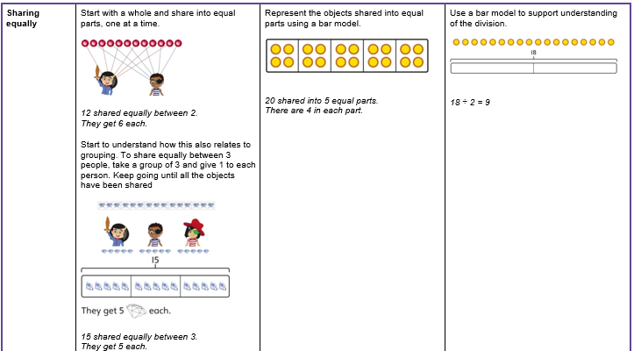
Division - Y2

Slide 16
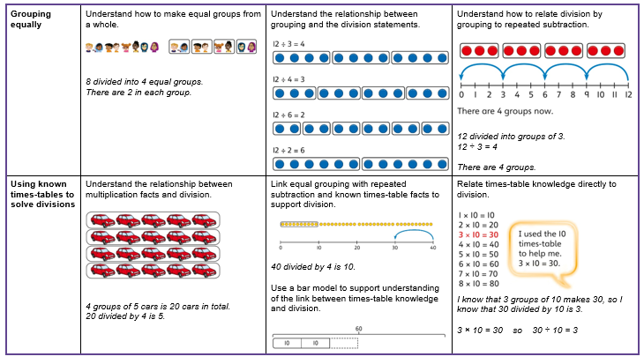
Division - Y2

Slide 17
Homework
Discuss the task.
What do they plan to do?
How will your child challenge themselves? ‘Must, should or could’?
Do you have anything that could help? Books, online searching together
Share your experiences

Slide 18
Basic Skills
Independence – packing their own bags etc
Perseverance when completing activities showing your child it is okay to make mistakes but to try a different way.
Making a sandwich
Telling the time

Slide 19
Any questions?

